Slide 1

Library Briefing Session for FB Capstone Project
William Ho
Faculty Librarian (Business)
lbwkho@polyu.edu.hk

Slide 2
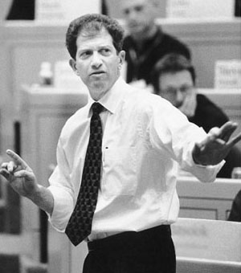
Quote of Today
Knowing where and how to find critical information is often the difference between successful and unsuccessful decisions.
Prof. David A. Garvin
Professor of Business Administration
Harvard Business School

Slide 3
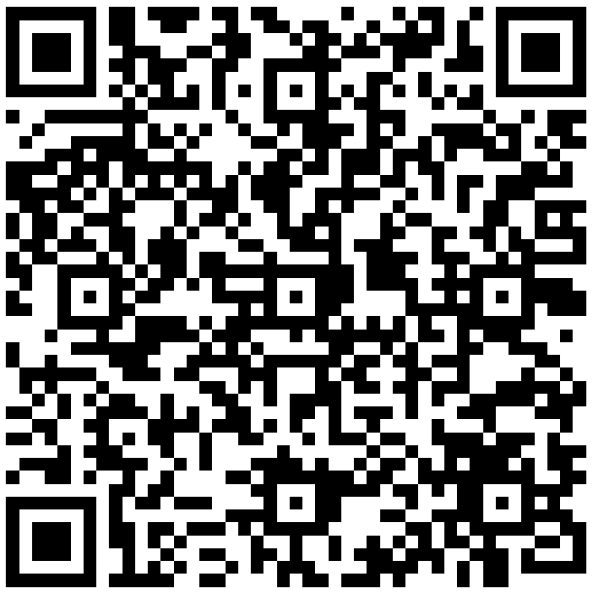
Advanced Library Workshop for FB Capstone Project
Time: 6:30pm – 8:00pm, 9 Sept (Tue)
Online via Zoom
Also stay tuned to the registration email to be sent out
within this week!
Enroll NOW!
Notes:
https://www.lib.polyu.edu.hk/workshops/register/tailor-made/advanced-library-workshop-for-fb-capstone-project-2025

Slide 4

Challenges of GenAI-Driven Tools in Research
Might provide generic, biased, or outdated information
Risk of inaccurate or fabricated sources undermining credibility
Limited depth compared to specialised databases

Slide 5





Professional Research Tools Used by
Business Practitioners at Your Library
And More…

Slide 6
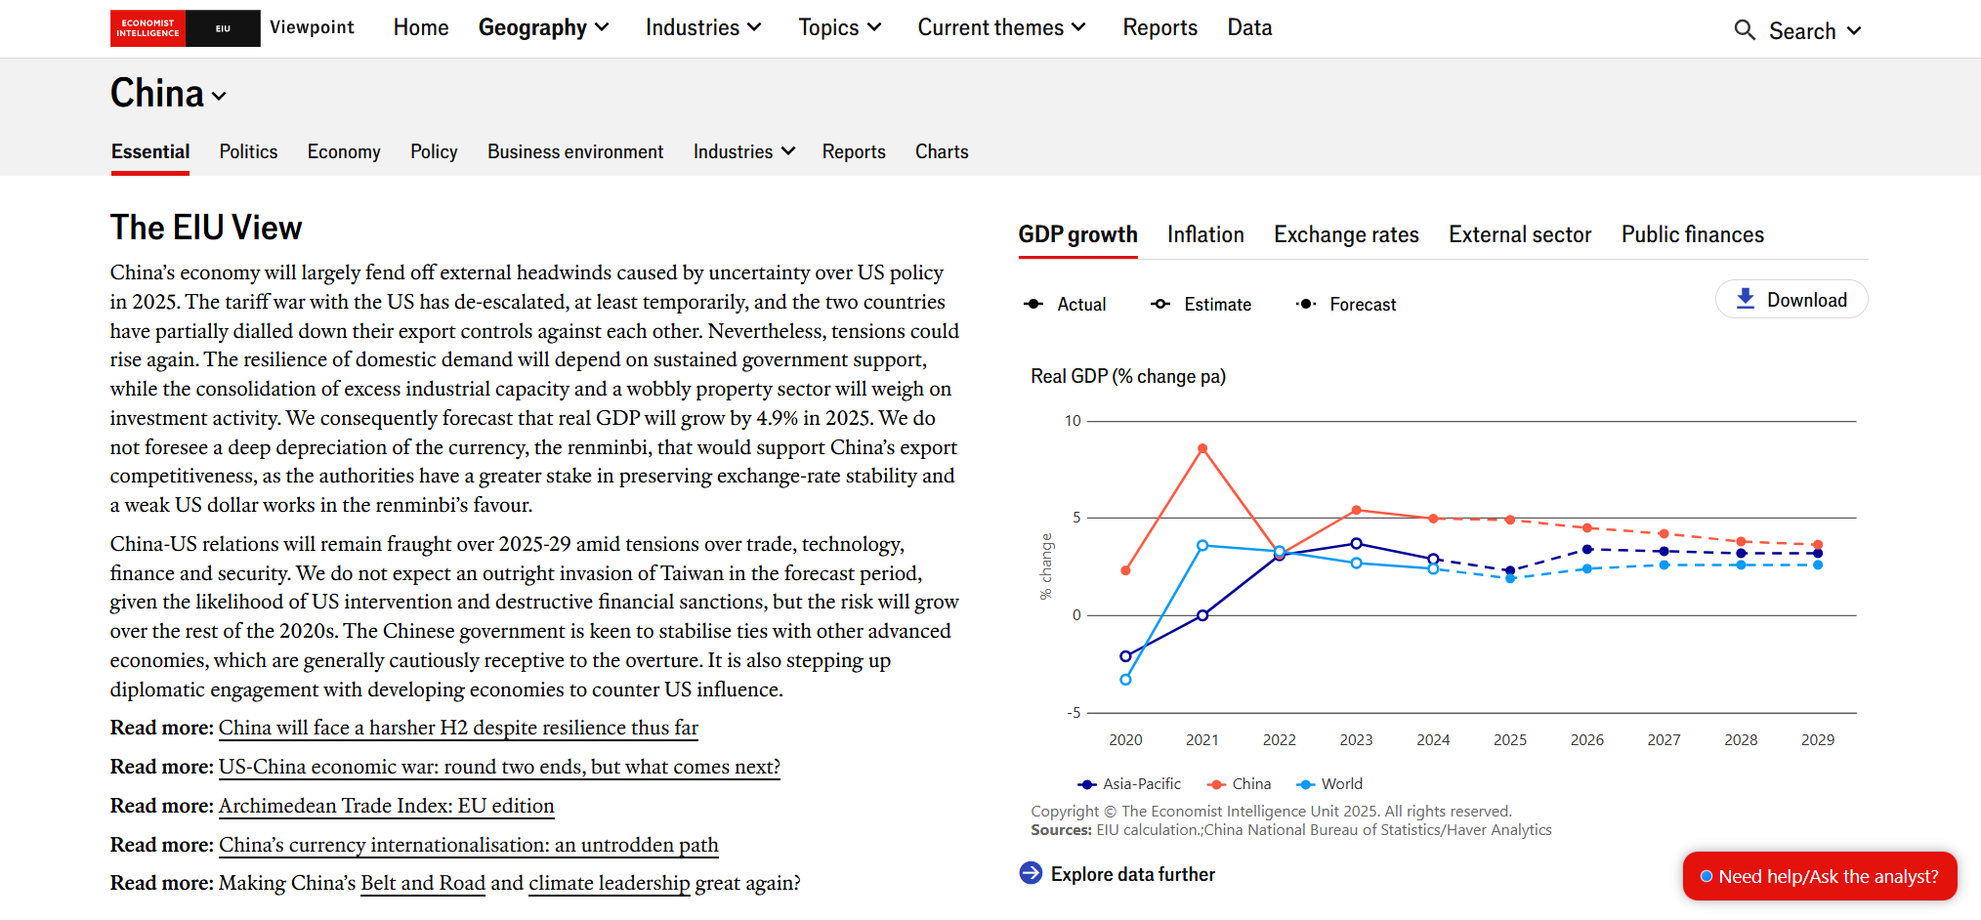
EIU Viewpoint Global economic forecasts and country analyses

Slide 7
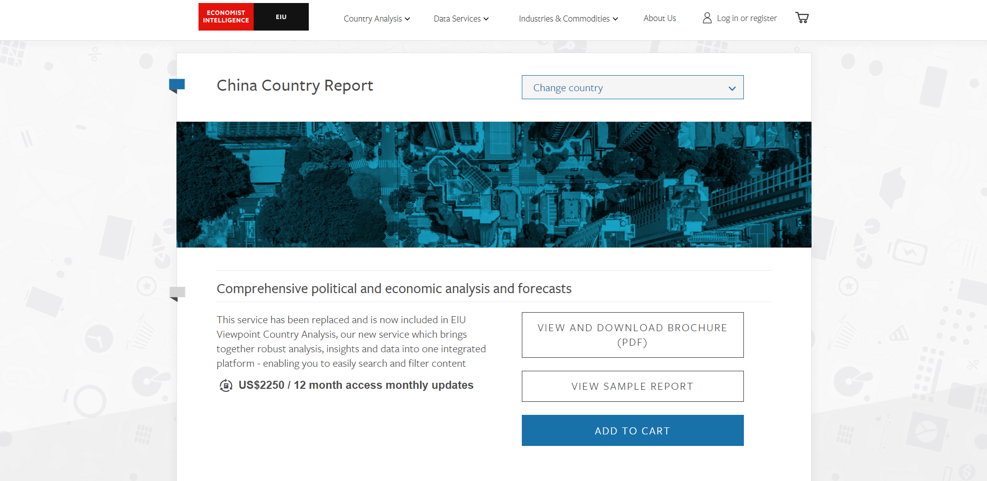

Slide 8
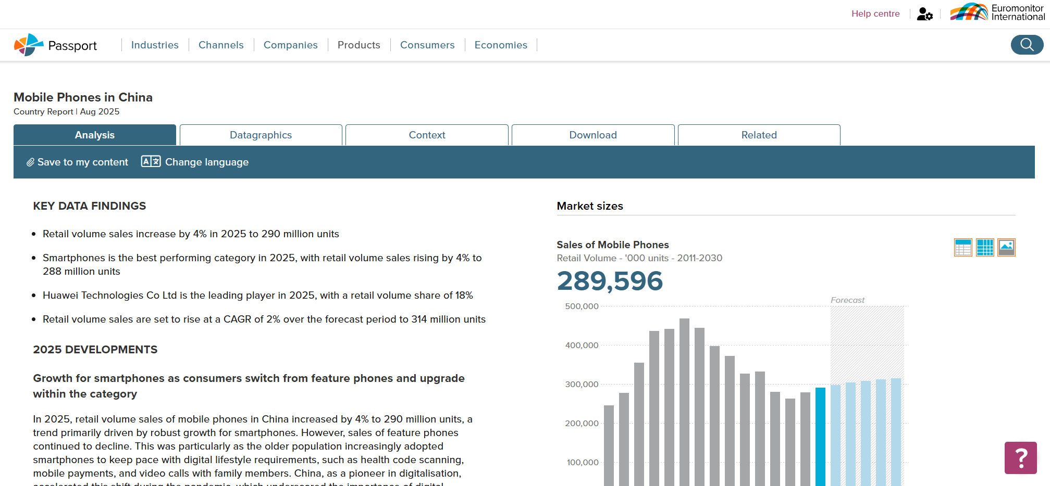
Passport Detailed market and consumer trend analysis across industries and regions

Slide 9
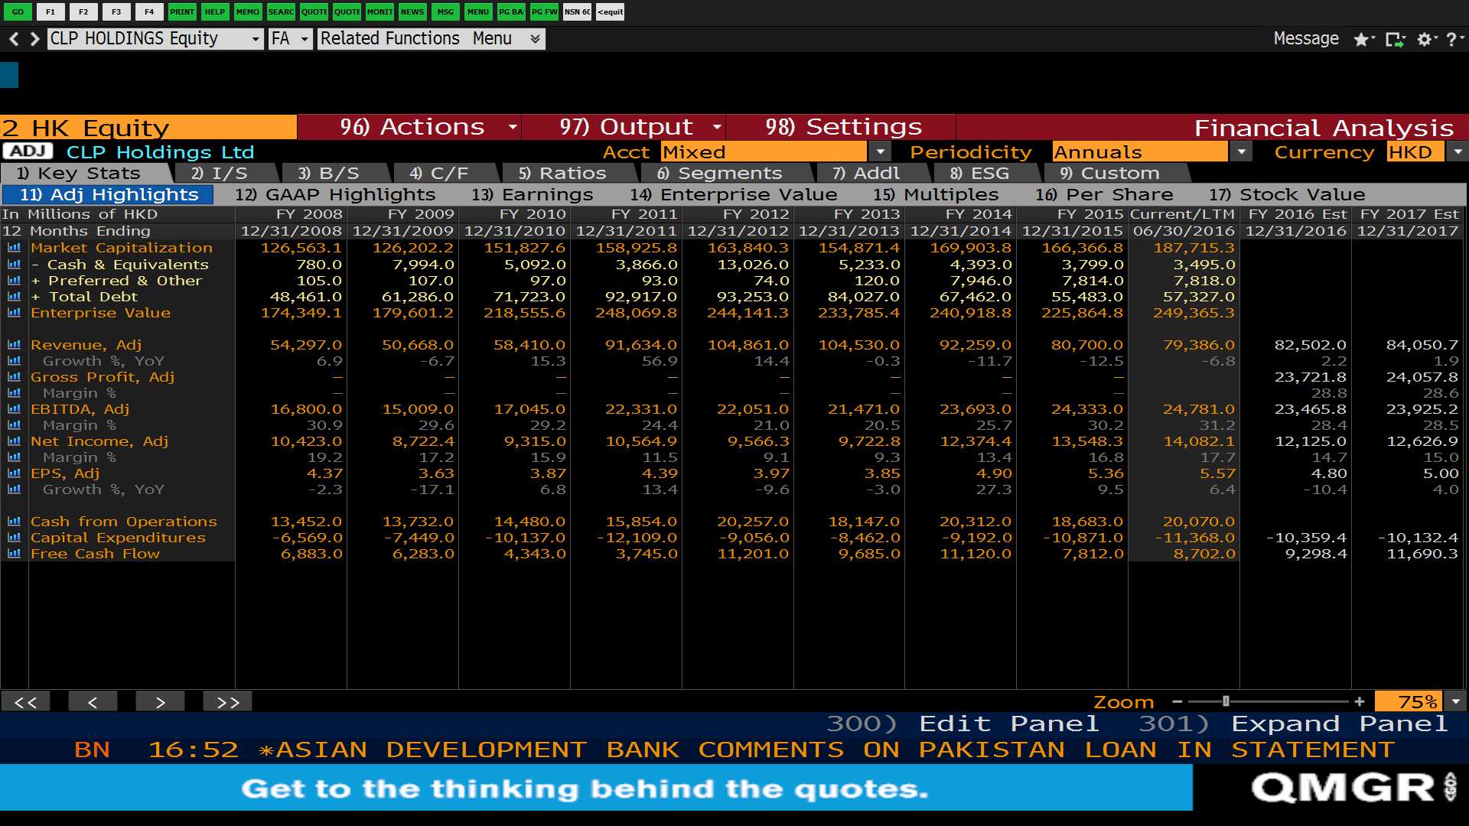
Bloomberg Professional Services Real-time financial data and analytical tools used by industry professionals
Notes:
Student Jo: Wow! That’s a wealth of information here. But where is the Dividend Payment located?
Librarian: It’s under Addl tab.

Slide 10
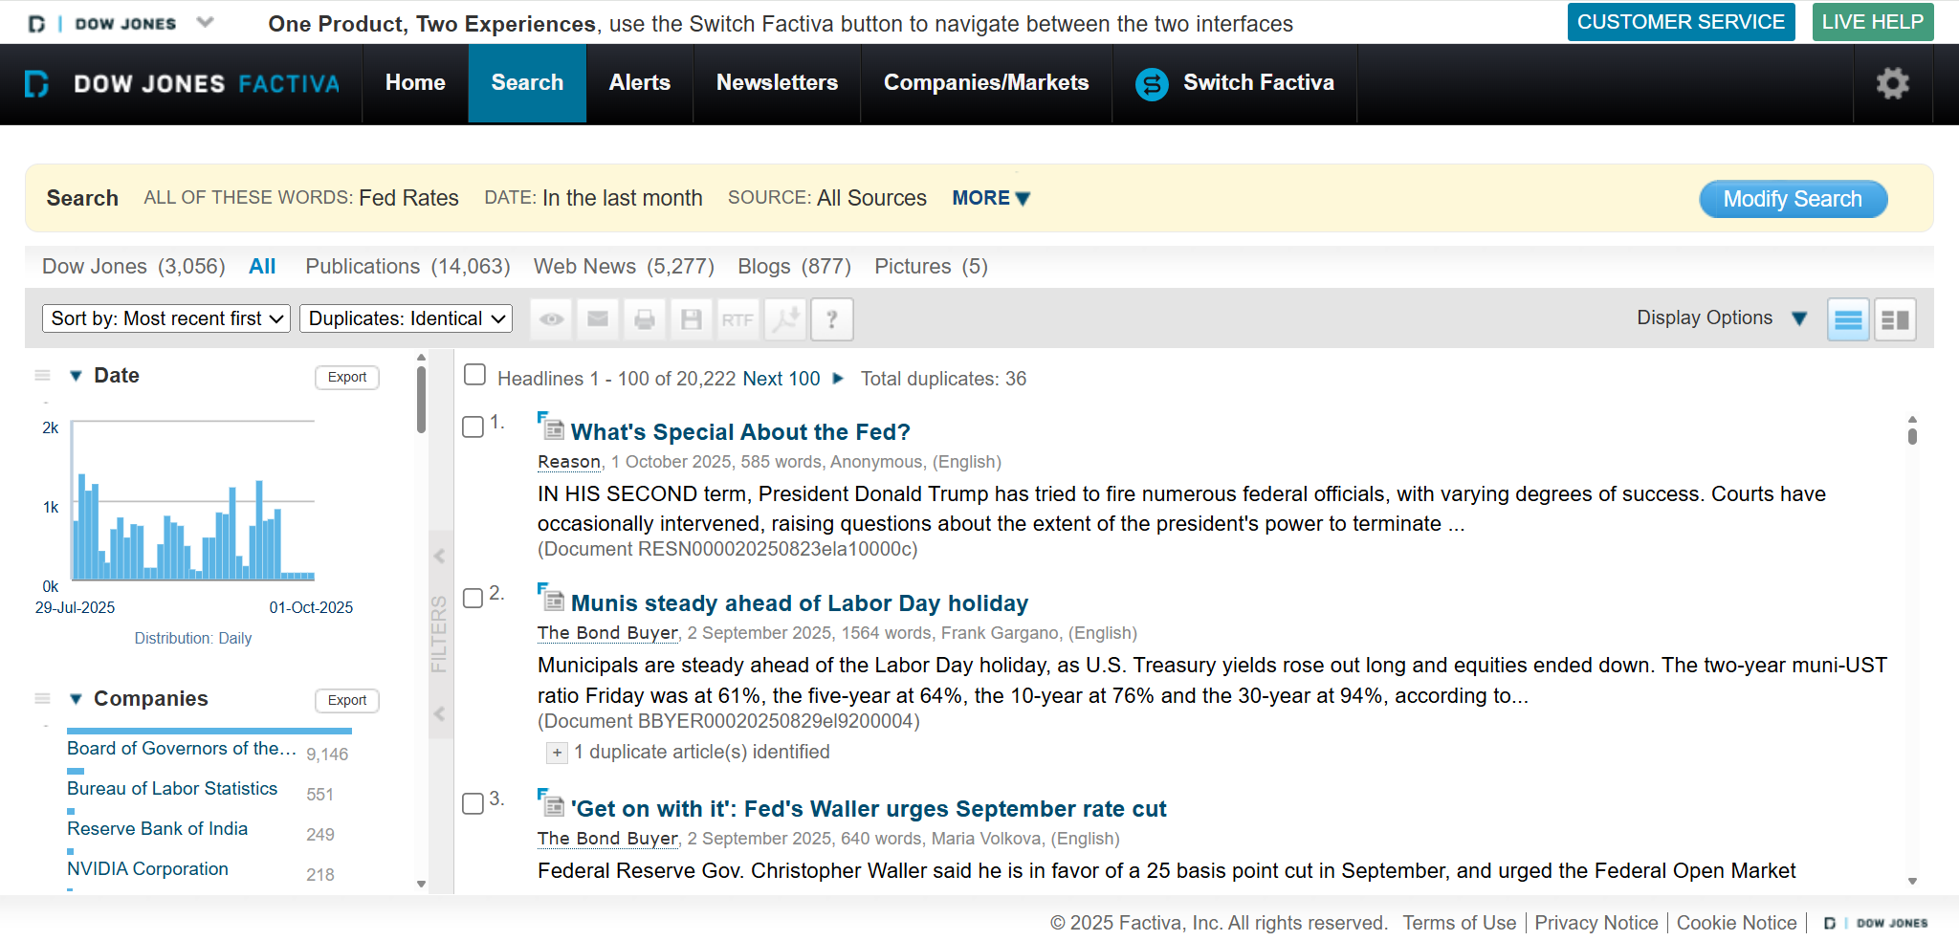
Factiva Global news and industry insights from thousands of premium sources

Slide 11
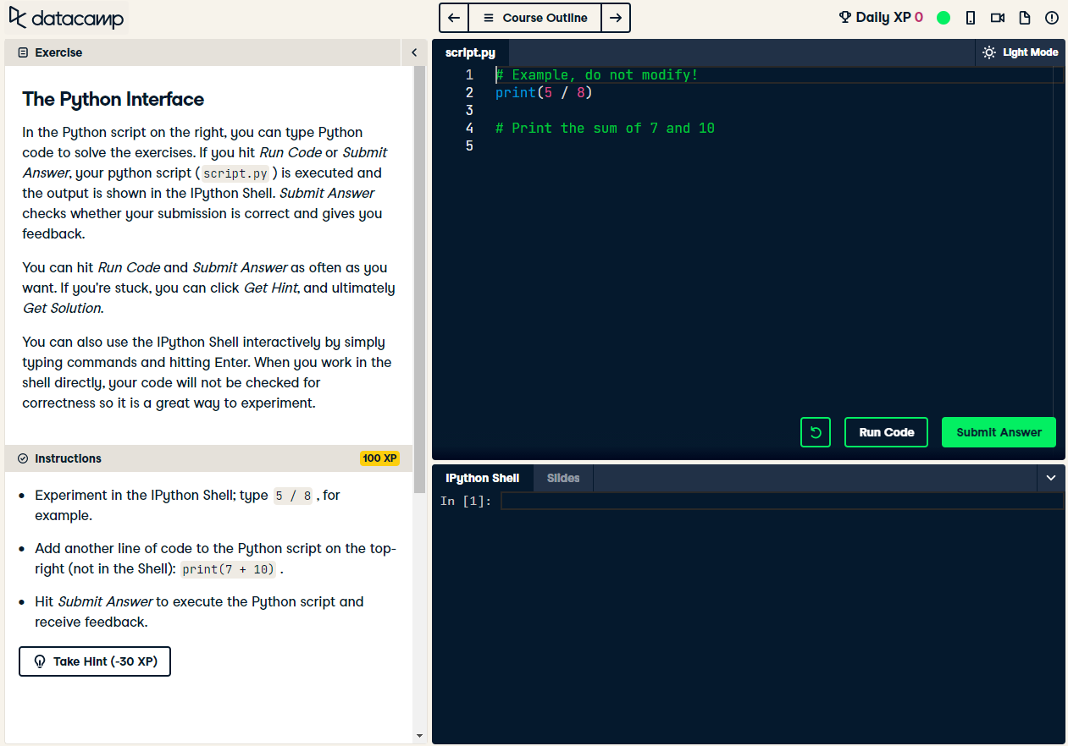
Datacamp 590+ online courses with hands-on exercises to learn data science. E.g. Python, R

Slide 12
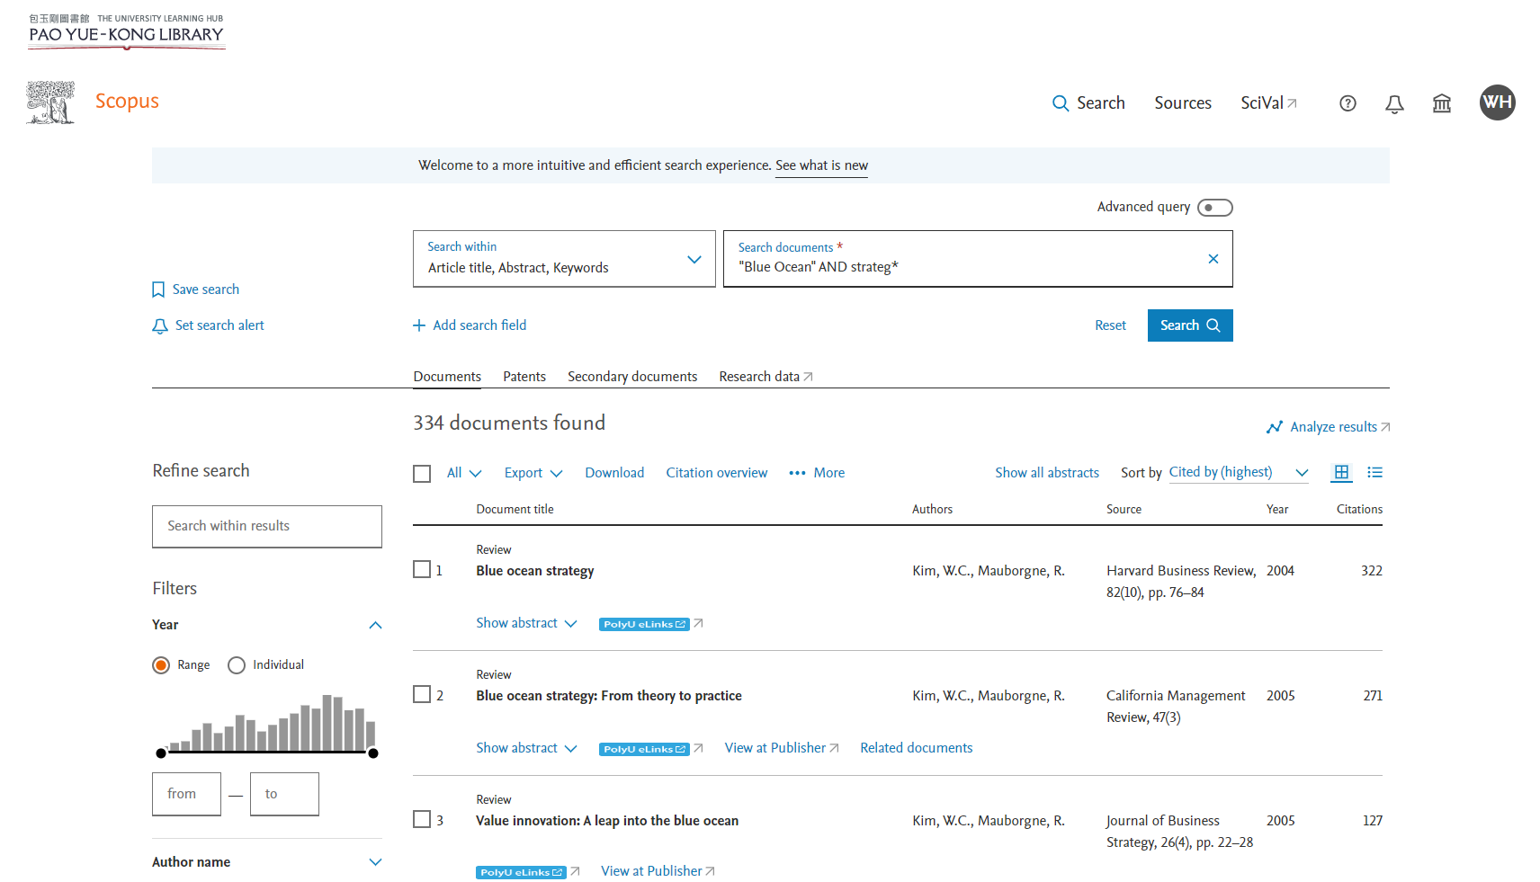
Scopus Comprehensive database of peer-reviewed articles to find impactful research papers

Slide 13
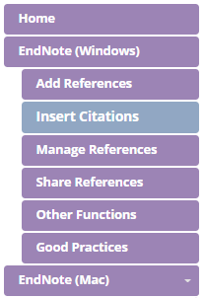
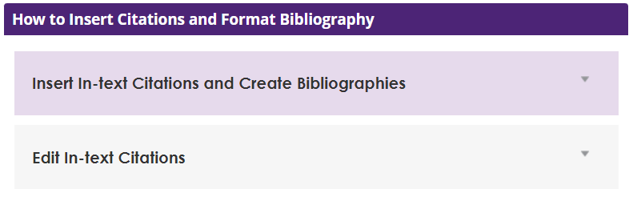
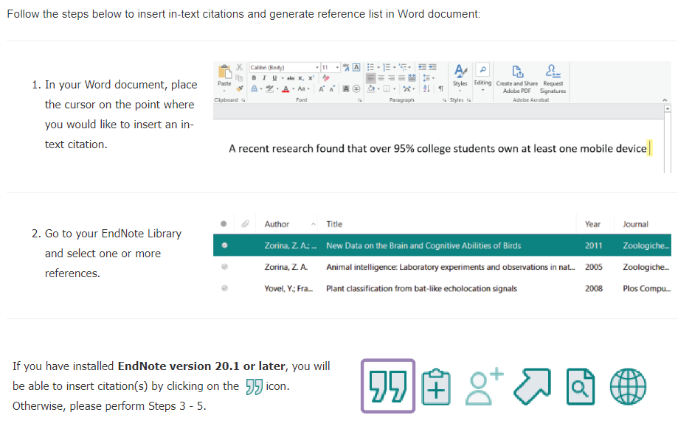
EndNote Reference Management Tools to collect, organize, and share your references effectively
Notes:
To insert multiple citations, you can select more than one reference by pressing the Ctrl key on your keyboard with left-click of your mouse, then click on the citation icon in EndNote.
Make sure that you insert all references in your Word document from the SAME EndNote library. This will help you to locate and edit the citations easier and avoid duplication of references added from different EndNote libraries.

Slide 14
Why This Workshop Matters
Efficiency: Quickly access high-quality, premier business sources
Credibility: Produce data-driven, authoritative research
Depth: Access specialised industry insights unavailable through general AI tools
Outcome: Elevate your research to meet academic and professional standards

Slide 15
Advanced Library Workshop for FB Capstone Project
Time: 6:30pm – 8:00pm, 9 Sept (Tue)
Online via Zoom
Also stay tuned to the registration email to be sent out
within this week!
Enroll NOW!
Notes:
https://www.lib.polyu.edu.hk/workshops/register/tailor-made/advanced-library-workshop-for-fb-capstone-project-2025

